Slide 1
Arduino Workshop #11
Using SD cards to make a Data Logger using Real Time Clocks (RTC)

Slide 2
PowerPoint and Code
Github.com/EELabMan
Go To Repositories and find Arduino 11 Real Time Clocks and Datalogging

Slide 3
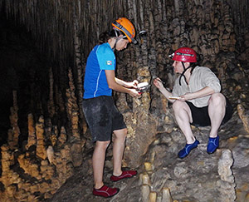
What it’s good for
Recording sensor data / voltages over a long period of time
Soil moisture, day light exposure, room entry, weather conditions are some examples.
Controlling motors at certain dates and times
Weather Station
GPS Tracker
Entry Logger
Light tracker
Soil Moisture
Automatic watering
Thousands of other things

Slide 4
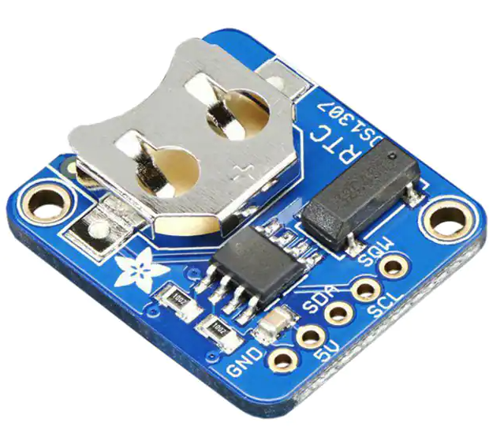
Parts needed for all projects
Arduino UNO w/ USB Cable
Micro SD Card reader w/level shifter 74HC4050
microSD card greater then 2Gb – Formatted to FAT32
Or microSD card greater 2Gb or less– Formatted to FAT
IR Distance Sensor
RTC ( Real Time Clock ) breakout board
Computer with micro SD card reader / USB Adapter
Jumper wires
Breadboard
Real Time Clock DS 1307

Slide 5
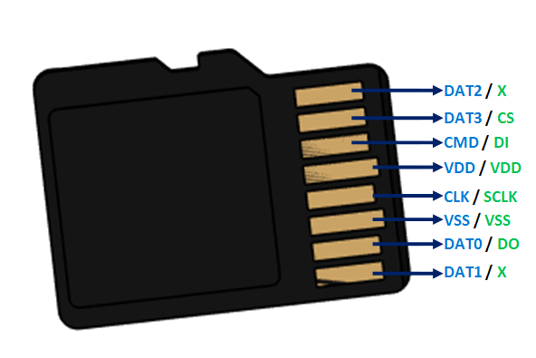
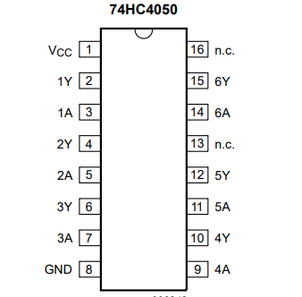
microSD Pinout / Level Shifter Pinout
SPI bus device
74HC4050 is a level shifter for the logic ( 5V to 3.3V)
DO (Data Out) does not need to be level shifted ( Uno reads a high at 3V )

Slide 6
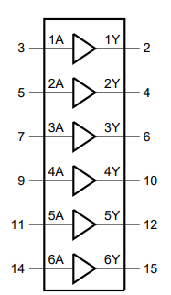

Pin assignments / Level shifted pins

Slide 7
Format microSD Card
Insert the microSD card into your computer
Copy any data you need to keep and place it on your desktop
Find the card in Windows Explorer ( or the Mac equivalent ), right click and select format.
Choose quick format and FAT32 if you card is over 2Gb and less than 32Gb
Arduino is limited to 32Gb maximum. Do not use a 64Gb SD card
Choose FAT if it’s lower than 2Gb.
Click Format.
Once formatted – Right click the card and choose Eject.

Slide 8
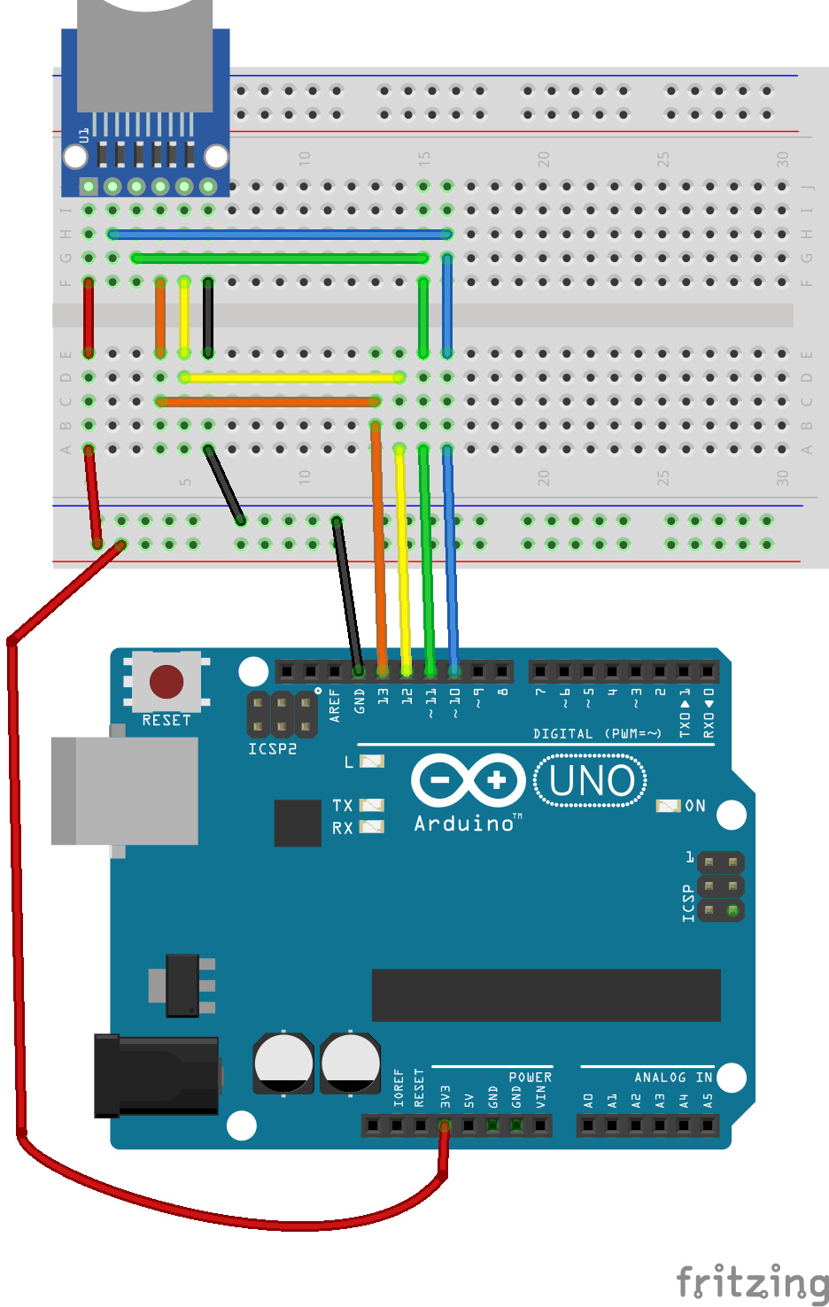
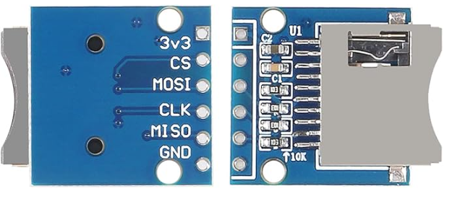
Let’s wire it up

Slide 9
SD Write test
Let see if we can write anything to the SD card
Go to our GitHub and download write_to_sd.ino
Open it in the Arduino IDE
Connect the Arduino to the computer and select the correct port
Upload the file to the Arduino
Open the serial monitor
If you see the message below – You did it! If not, check your wiring
Initializing Card
Card Ready
19,Hello There!

Slide 10
Check the Data on your computer
Power off the Arduino
Remove the SD card from the Arduino
Insert the SD into your computer
You should have the file LOG.CVS ( Comma Separated Value)
You can open it to see all the data the Arduino collected for you.

Slide 11
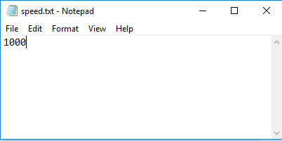
Read and Write Test
Let’s create a file for the Arduino to read
We’ll make it a Text file to set how often the Arduino reads the data.
Create a file named speed.txt on the SD card
Open speed.txt and insert the interval value you wish to collect the data
I’ll enter 1000 to set the Arduino to collect the data every second.
Save the file and Eject the SD card safely ( right click -> Eject )

Slide 12
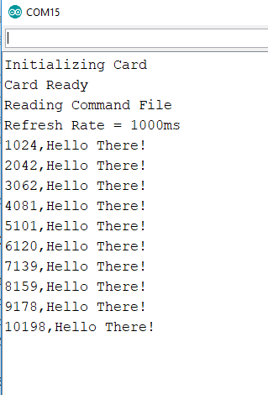
Upload the code
Put the SD card back into the Arduino card reader
Download the sd_read_write.ino file from our GitHub and upload it to the Arduino
Open the Serial Monitor, you should see Card Ready and Reading Command File and Refresh Rate = 1000ms
If not, please ensure you created the speed.txt file on your SD card and set it to 1000.
Also check the SO jumper

Slide 13
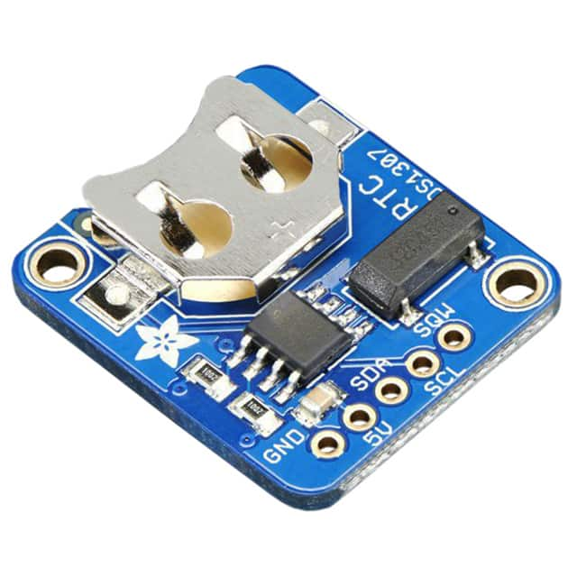
The Real Time Clock (RTC)
This is a great battery-backed real time clock (RTC) that allows your microcontroller project to
keep track of time even if it is reprogrammed, or if the power is lost.
Perfect for datalogging, clock-building, time stamping, timers and alarms, etc.
The DS1307 is the most popular RTC – but it requires 5V power to work (although we've used it with 5V power and 3.3V logic successfully)
Works great with an Arduino using our RTC library
Will keep time for 5 years or more
Not high precision.
Add the RTClib-master.zip file from our GitHub to the Documents\Arduino\Libraries folder
In the Arduino IDE : Sketch -> Include Library -> Add ZIP Library
Select the RTClib-master.zip and open it.

Slide 14
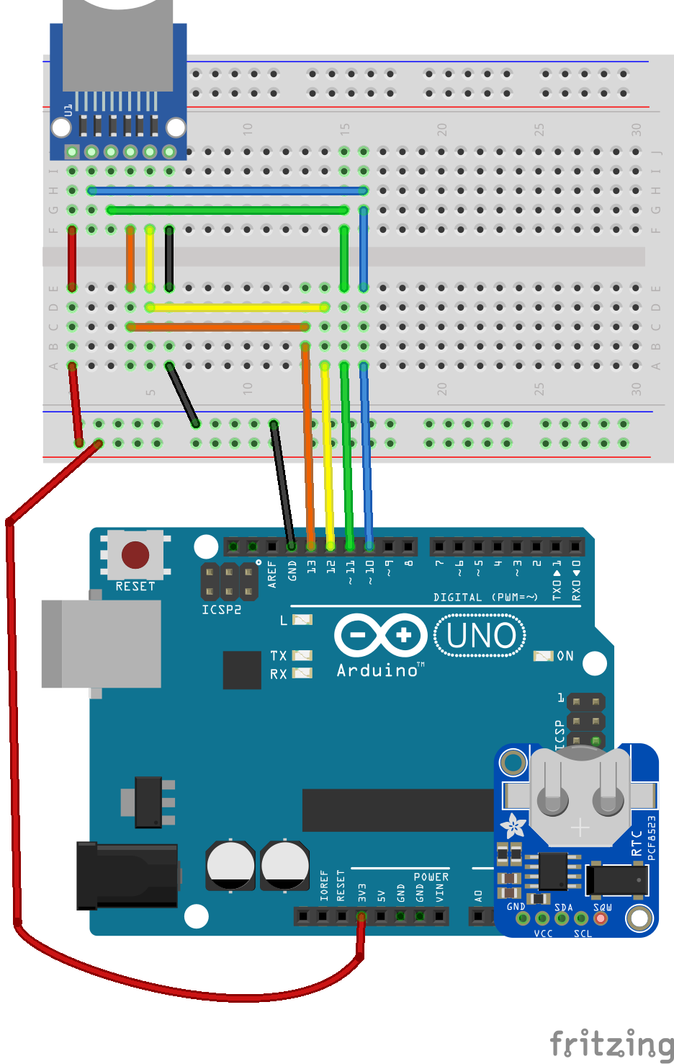
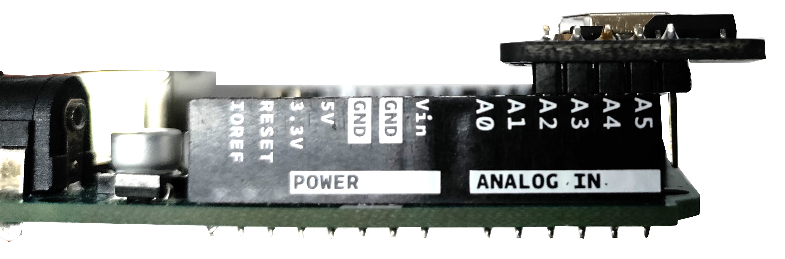
Install the RTC
Install the battery into the RTC
With power off – Plug the RTC into the Arduino
THE SQW Pin hangs off the Arduino! GND goes to A2
SQW Pin hangs outside the
Arduino Header

Slide 15
Install BUS Library
Sketch -> Include Library -> Manage Libraries
Search for Adafruit Bus
Install Adafruit BusIO
This will fix a compiling error.

Slide 16
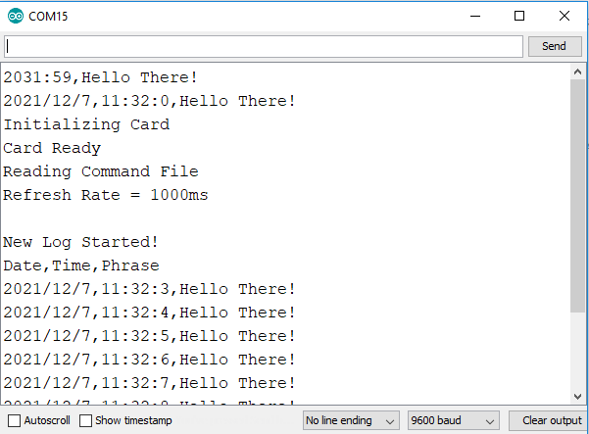
Upload the code
Download the sd_read_write_rtc.ino file from GitHub
Plug in the power and upload it
Open the serial monitor
You should get the Hello There! Statement with the current Time and Date.

Slide 17
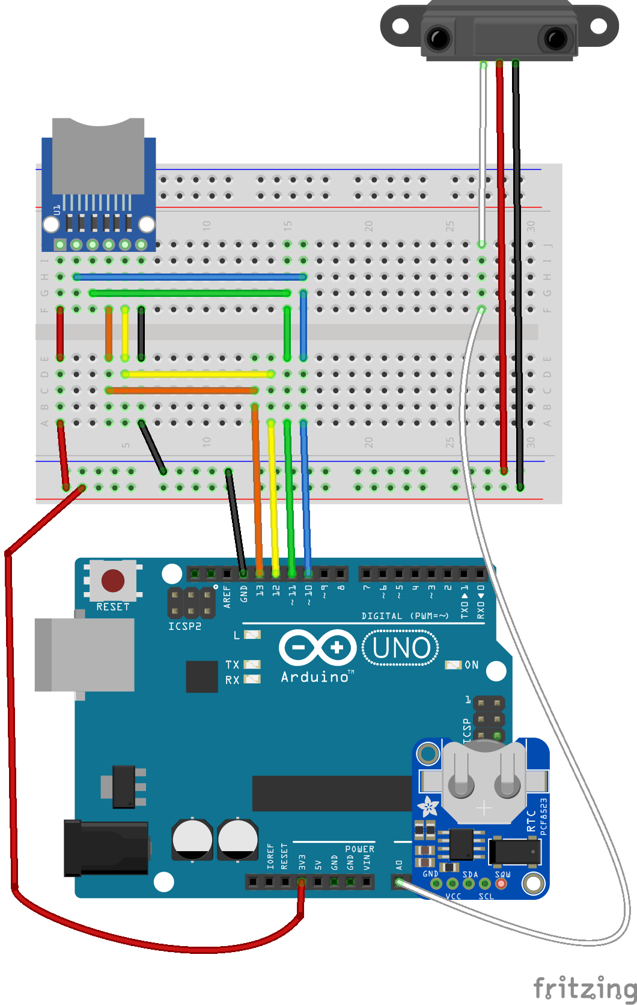
Entrance Logger
Connect the IR Sensor
Notice the RED lead goes to GROUND!!
Notice the BLACK lead goes to 3.3V!!
Download the entrance_logger.ino from our GitHub and upload

Slide 18
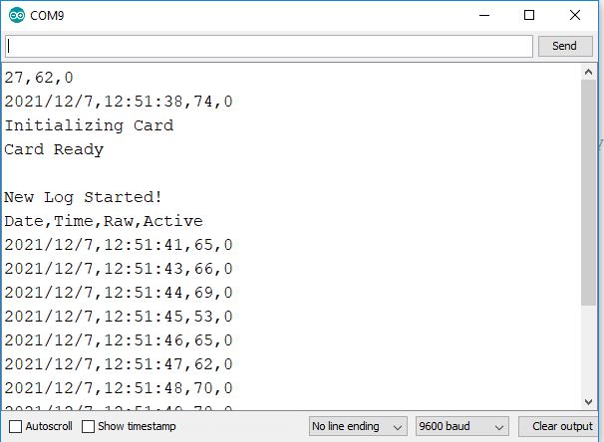
Entrance Logger
Open the serial monitor.
Observe the data when moving your hand past the sensor

Slide 19
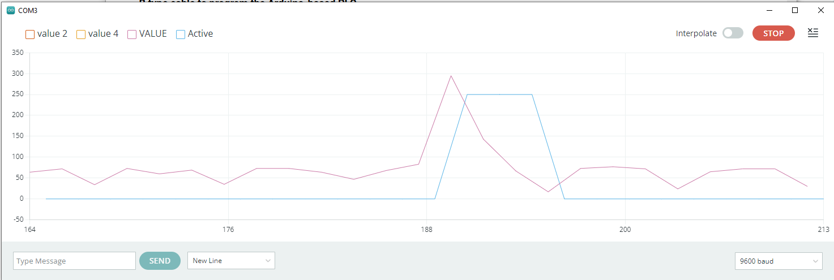
Open the Serial Plotter
Close the Serial Monitor and Open the Serial Plotter ( under the tools menu )
Select VALUE and Active
Disconnect power to the Arduino and insert the card into your computer.
Open the LOG.CVS and find the data at the bottom.
Select the first three columns and create a chart to see “how many people entered the room”

Slide 20
Not the end of the road by far
Even though this is that last workshop in the Arduino series this semester, there are thousands of projects on YouTube and online.
We hope you’ve enjoyed these workshops and continue to develop your skills.

